Slide 1



Phạm Minh Đức
CHALLENGE “0”
What’s my current version?
minhduc027870@gmail.com
https://www.linkedin.com/in/ducpm412/

Slide 2

CONTENT
01
What’s Top Down Approach & How to appy it on assigment
02
Learning how to learn & learn fast
03
Autonomy at work
04
What is smart question? How to apply it on daily basis/work

Slide 3
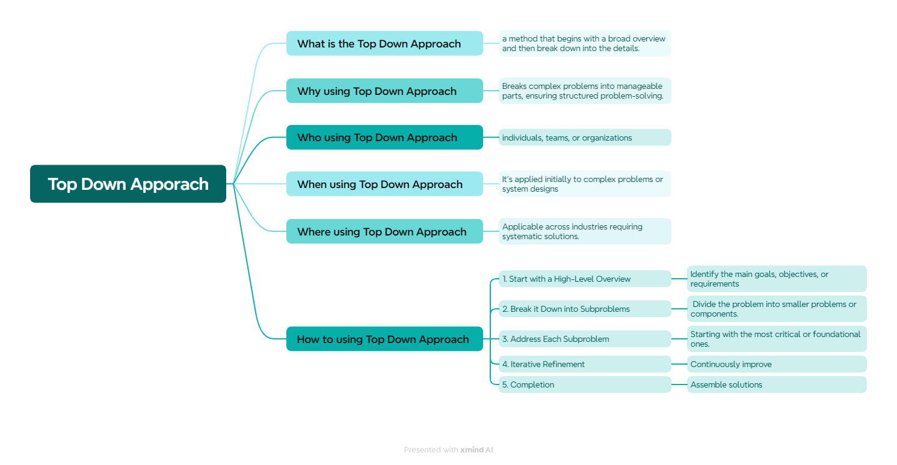
TOP DOWN APPROACH & HOW TO APPLY IT?

Slide 4
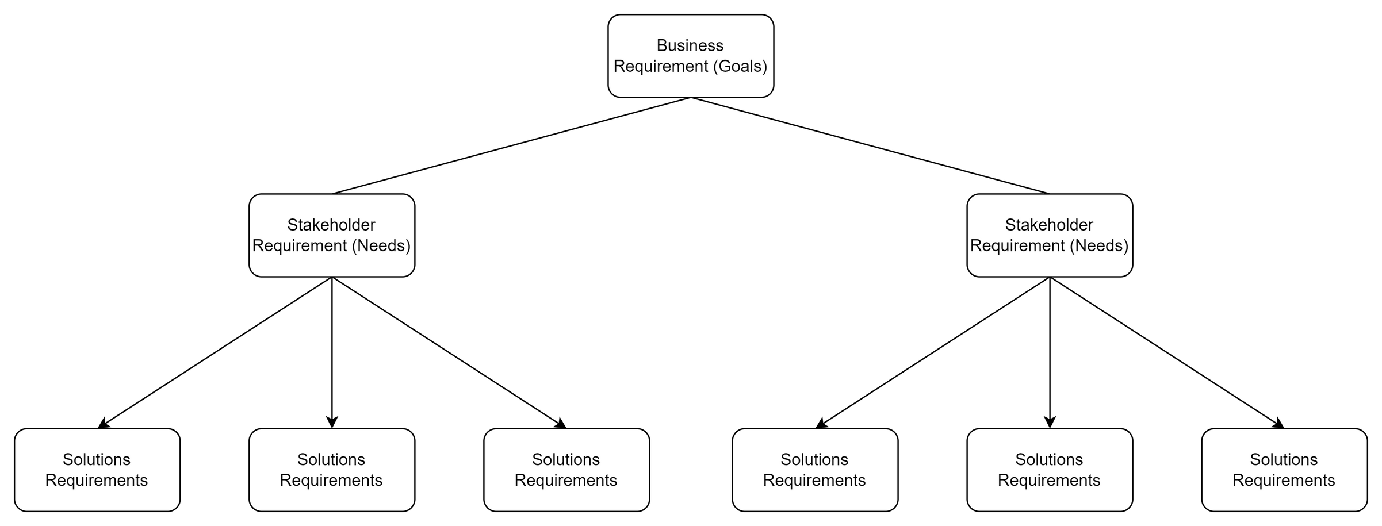
EXAMPLE: REQUIREMENT IN ELICITATION & ANALYSIS

Slide 5
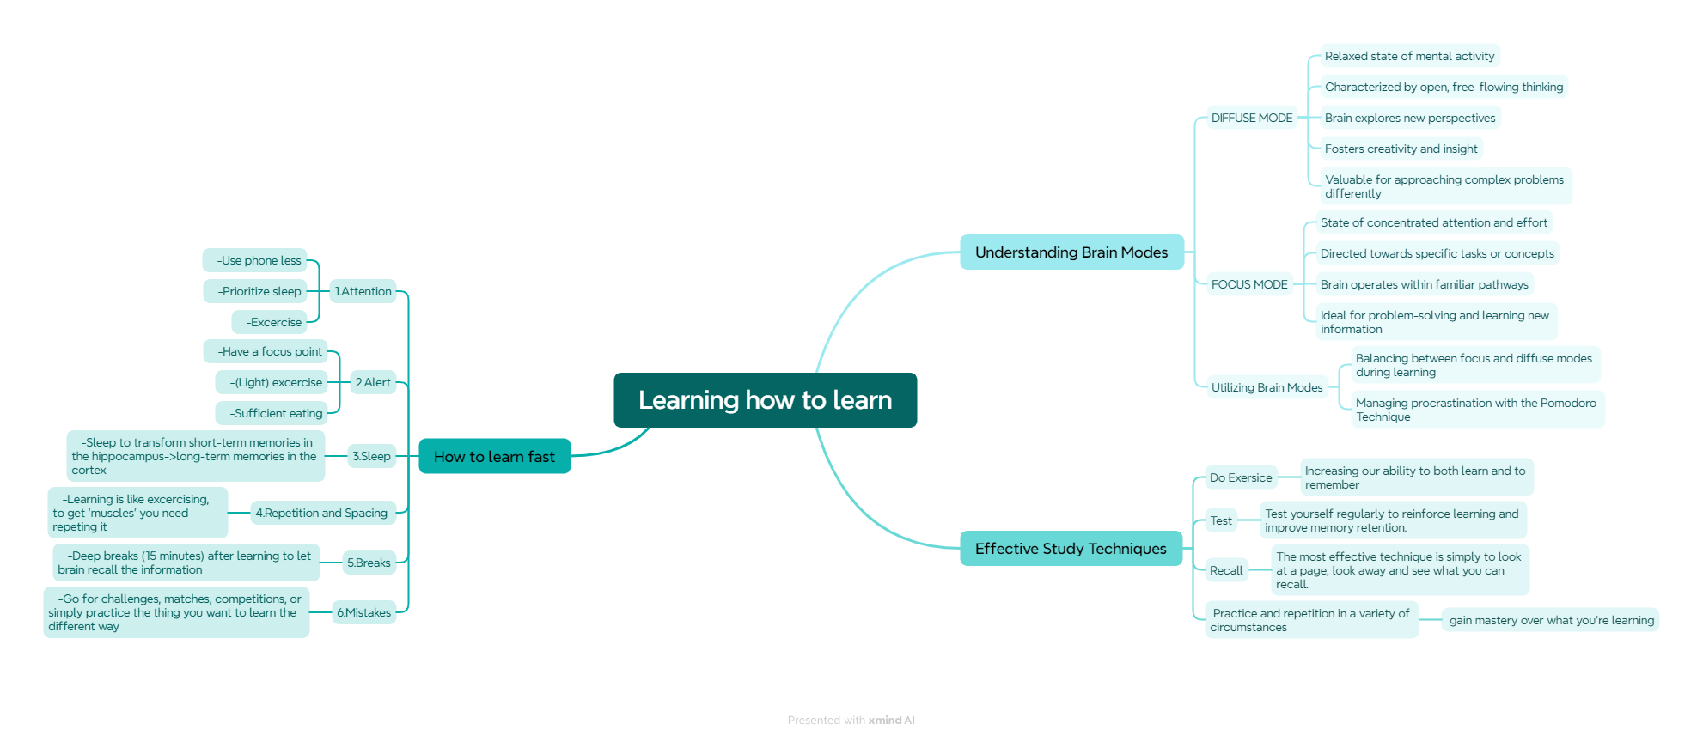
LEARNING HOW TO LEARN & LEARN FAST
“learn”
verb
UK /lɜːn/ US /lɝːn/
Learning is the process of gaining or acquiring knowledge of or skill in (something) by study, experience, or being taught

Slide 6
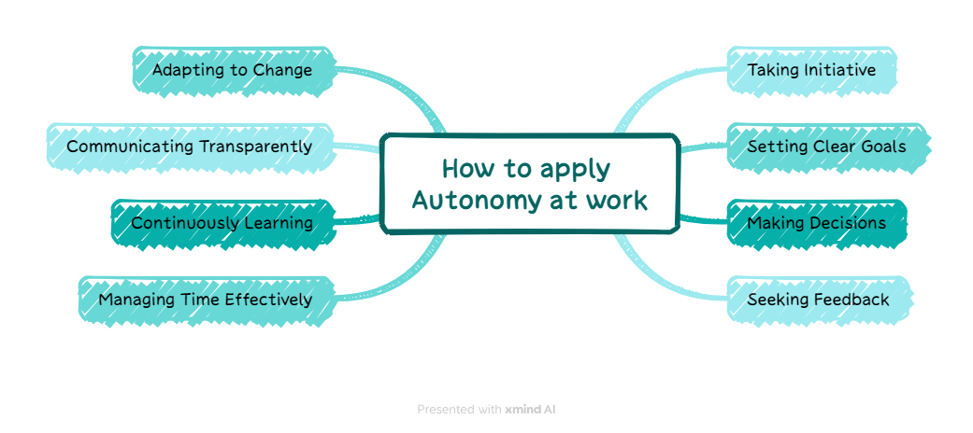
AUTOMOMY AT WORK
Defintion
As per Harvard Business Review, “Autonomy is a feeling of being in control and having a choice. When we have choices, we experience natural rewards of feeling positive.”
Autonomy at work means having the freedom and independence to make decisions, set goals, and manage tasks without constant supervision from superiors
Benefits
Increased Motivation
Higher Job Satisfaction
Enhanced Creativity and Innovation
Improved Performance
Better Work-Life Balance
Greater Employee Retention

Slide 7
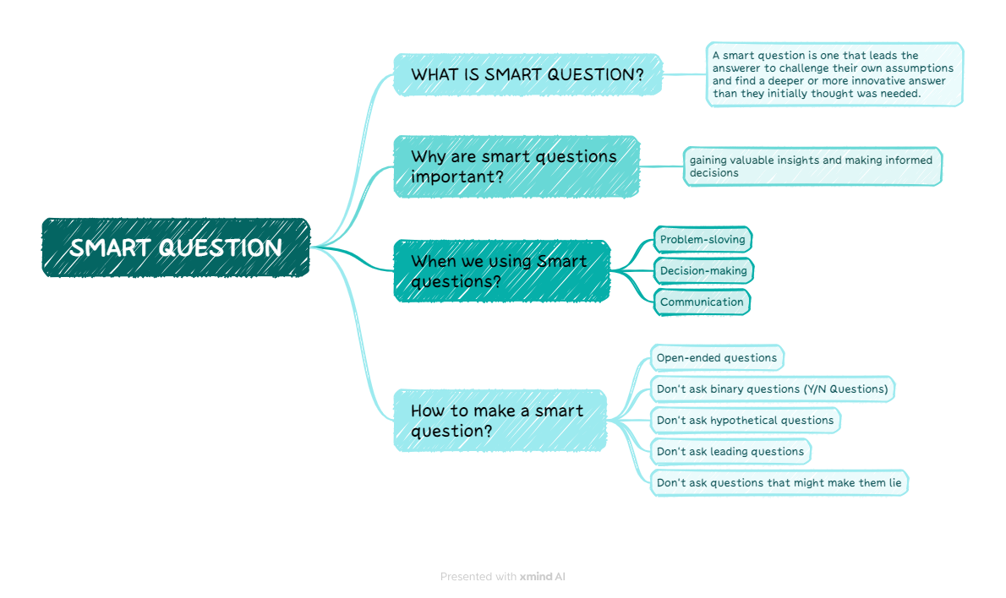
WHAT IS SMART QUESTION & HOW TO APPLY IT

Slide 8
REFERENCES
1. Bottom-up vs. top-down project management 101
2. Top-down approach vs. bottom-up approach: What’s the difference?
3. Learning how to learn | Barbara Oakley | TEDxOaklandUniversity
4. Brain Hack: 6 secrets to learning faster, backed by neuroscience | Lila Landowski | TEDxHobart
5. Autonomous Work–How to Create a Culture of Low Authority and High Accountability
6. Employee autonomy at work: The catalyst to effective employee engagement
7. What is an intelligent question?
8. Do you ask SMART questions?
9. Chat GPT 3.5

Slide 9

Phạm Minh Đức
THANK YOU
FOR YOUR ATTENTION
March 2024
minhduc027870@gmail.com
https://www.linkedin.com/in/ducpm412/

